Slide 1
Android Bluetooth Stack PPT
--Haranatth--

Slide 2
Basic Knowledge of Bluetooth:
Bluetooth (Bluetooth) is a wireless technology standard that can realize short-distance data exchange between fixed devices, mobile devices and building personal area networks. Bluetooth is based on the low-cost transceiver chip of the device, with short transmission distance and low power consumption.
BT vs WiFi:
Bluetooth Technology invention has been credited to Ericsson which in the year 1994 launched it as a wireless communication alternative to RS232.Wi-Fi, though had researches since the mid 80s, was officially launched in the year 1997.
Bluetooth was initially defined under IEEE 802.15.1 standard but is now taken care by a Special Interest Group (SIG). Wi-Fi, on the other hand, is defined under 802.11.x (x=a, b, c, and so on) series of protocols and is currently maintained under the same
Bluetooth works at 2.4GHz frequency while Wi-Fi based networks work at 2.4, 3.6 and 5 GHz .
The latest additions to Bluetooth (Bluetooth 4.0) promises data transfer rates to be upto 25mbps while latest Wi-Fi version of Wi-Fi direct can reach upto 250mbps of data transferring rate.
Maximum range for Bluetooth based wireless connections is 30m while for Wi-Fi, it can extend well upto 100m.
In Bluetooth, upto 7 devices can be connected to each other (piconet) while in Wi-Fi, the maximum connections depend on Wi-Fi router which can accommodate 1 to several communicating devices at a time.
Bluetooth uses frequency hopping technology to divide the transmitted data into data packets, and transmit the data packets through 79 designated Bluetooth channels
Each device has a unique 48-bit address. However, these addresses are not displayed in the connection request. However, the user can name his Bluetooth device (Bluetooth device name), and this name can be displayed in the scan results of other devices and the list of paired devices.

Slide 3
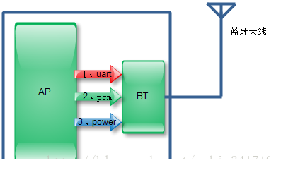
Bluetooth Hardware Interface:
Bluetooth hardware interface (take the chip connected to the UART interface as an example):
(1) UART part: serial port, mainly responsible for data transmission;
(2) PCM part: voice interface, used for voice data transmission during a call;
(3) Power part: power control.
The basic working principle of PCM:
Pulse modulation is to transform a time-continuous, continuous-valued analog signal into a time-discrete digital signal, which is then transmitted in the channel.
Pulse code modulation is to sample the analog signal first.After an analog signal is sampled and quantized, a quantized pulse amplitude modulation signal is obtained, which is only a finite number of values
The PCM voice signal is first passed through an anti-aliasing low-pass filter, and pulse sampling is performed to become a sampling signal with a repetition frequency of 8KHz (that is, a discrete pulse amplitude modulation PAM signal), and then the PAM signal with continuous amplitude is quantized to be limited by "rounding" method A signal with an amplitude value is encoded and converted into a binary code

Slide 4
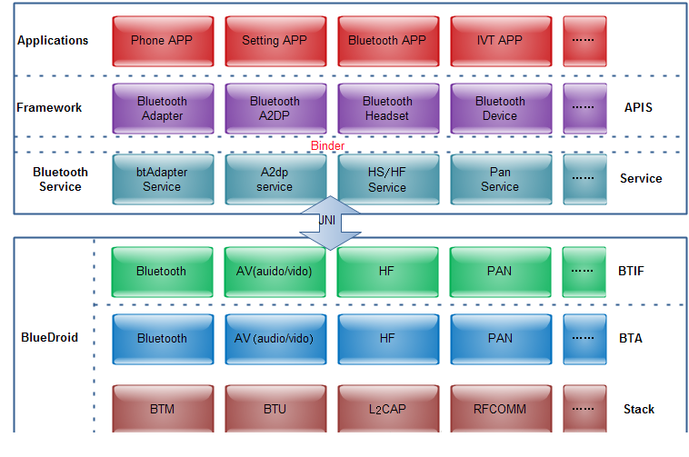
Android Bluetooth Architecture:
BlueDroid && BlueZ:
Before Android 4.2, Google has been using the official Linux Bluetooth protocol stack BlueZ.
Starting from Android 4.2, Google has introduced BlueDroid developed by it and Broadcom in the Android source code to replace BlueZ.
Compared to BlueZ, the most commendable part of BlueDroid is that its frame structure has become more concise and clear and BlueZ's DBUS.
The overall protocol stack architecture of bluedroid(from Android 4.2)

Slide 5
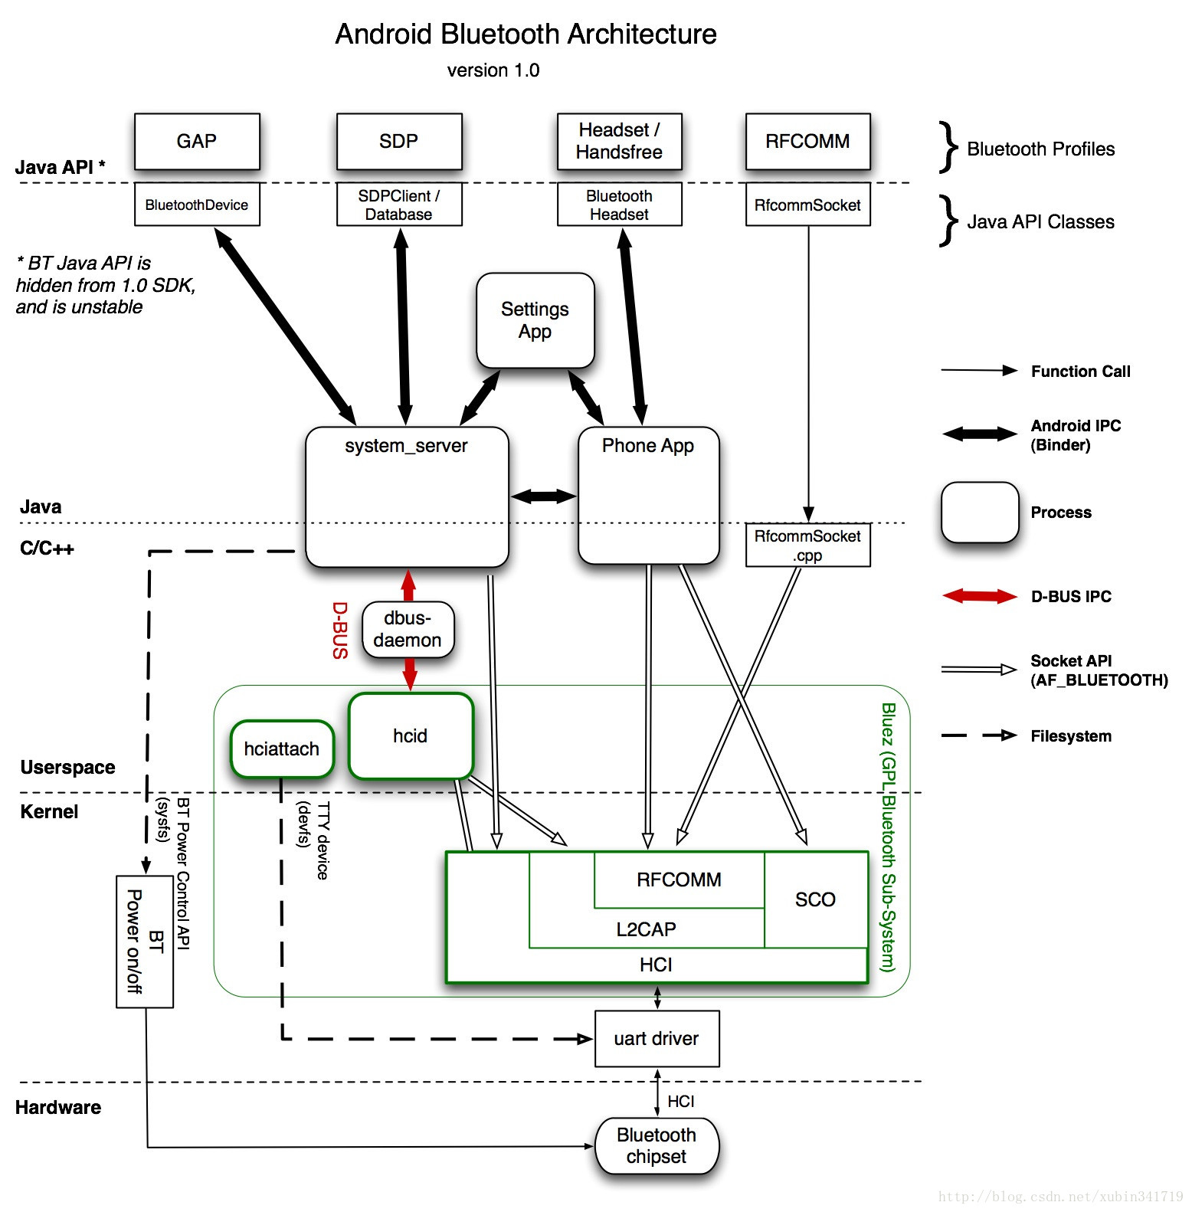
Android Bluetooth Architecture:
The BlueZ code architecture:
GAP(Generic Access Profile):Defines a general method for Bluetooth to establish a baseband link to ensure that two Bluetooth devices can communicate with each other.
SDP ( Service Discovery Profile ): It is used to discover the Service supported by the other party's Bluetooth . For example, if I connect a headset, whether the headset can only make calls, can make calls and listen to music, or can only listen to music, this is all discovered through SDP
Headset/Handsfree : These two profiles are used to implement call-related content.
RFCOMM : This is a basic profile . Many applications are implemented based on it, such as our file transmission
GATT

